Slide 1



Implementing Compliant Authentication and Authorisation using MyAccessID and Keycloak
Christopher Woods
Bristol Centre for Supercomputing (BriCS)
MyAccessID Online Workshop – 2nd December 2025

Slide 2
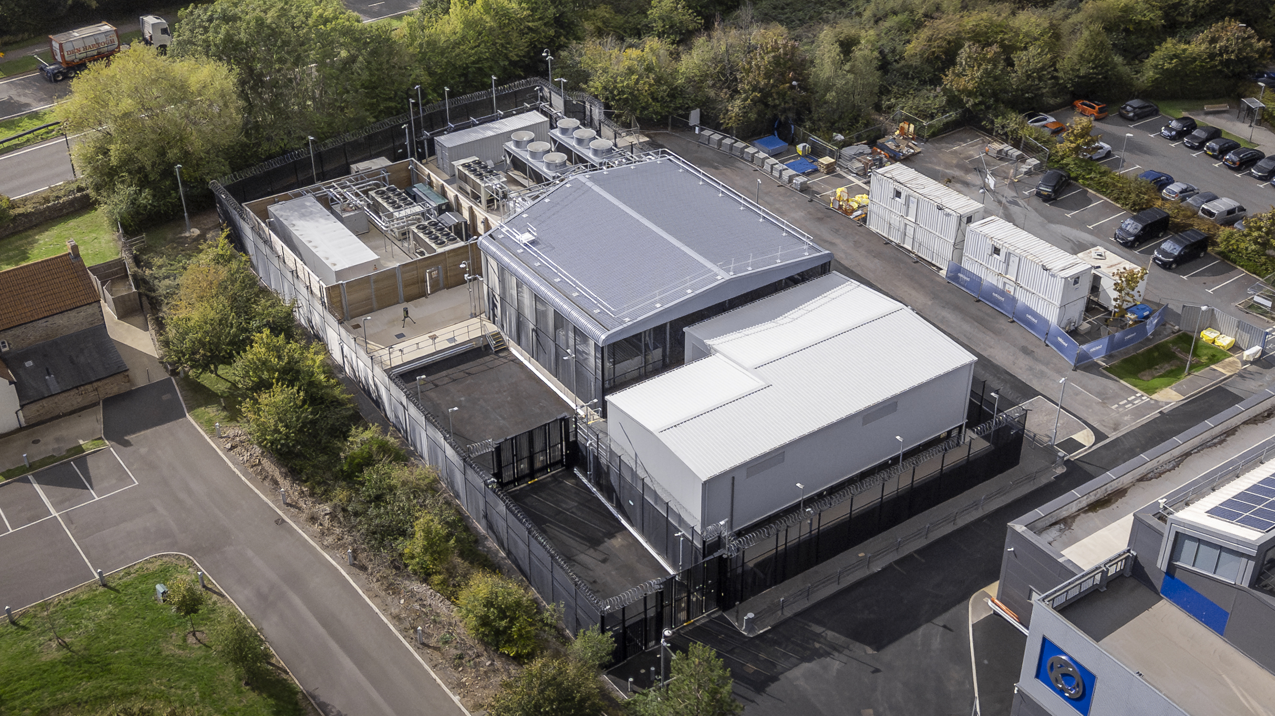
Cooling
Isambard-AI UPS
Switch gear house
(transformers)
Isambard 3 &
Isambard-AI phase 1
Isambard-AI phase 2
Water treatment
& heat recovery
MyAccessID deployed at Bristol
Used for Isambard-AI, Isambard 3, BlueCrystal 5

Slide 3
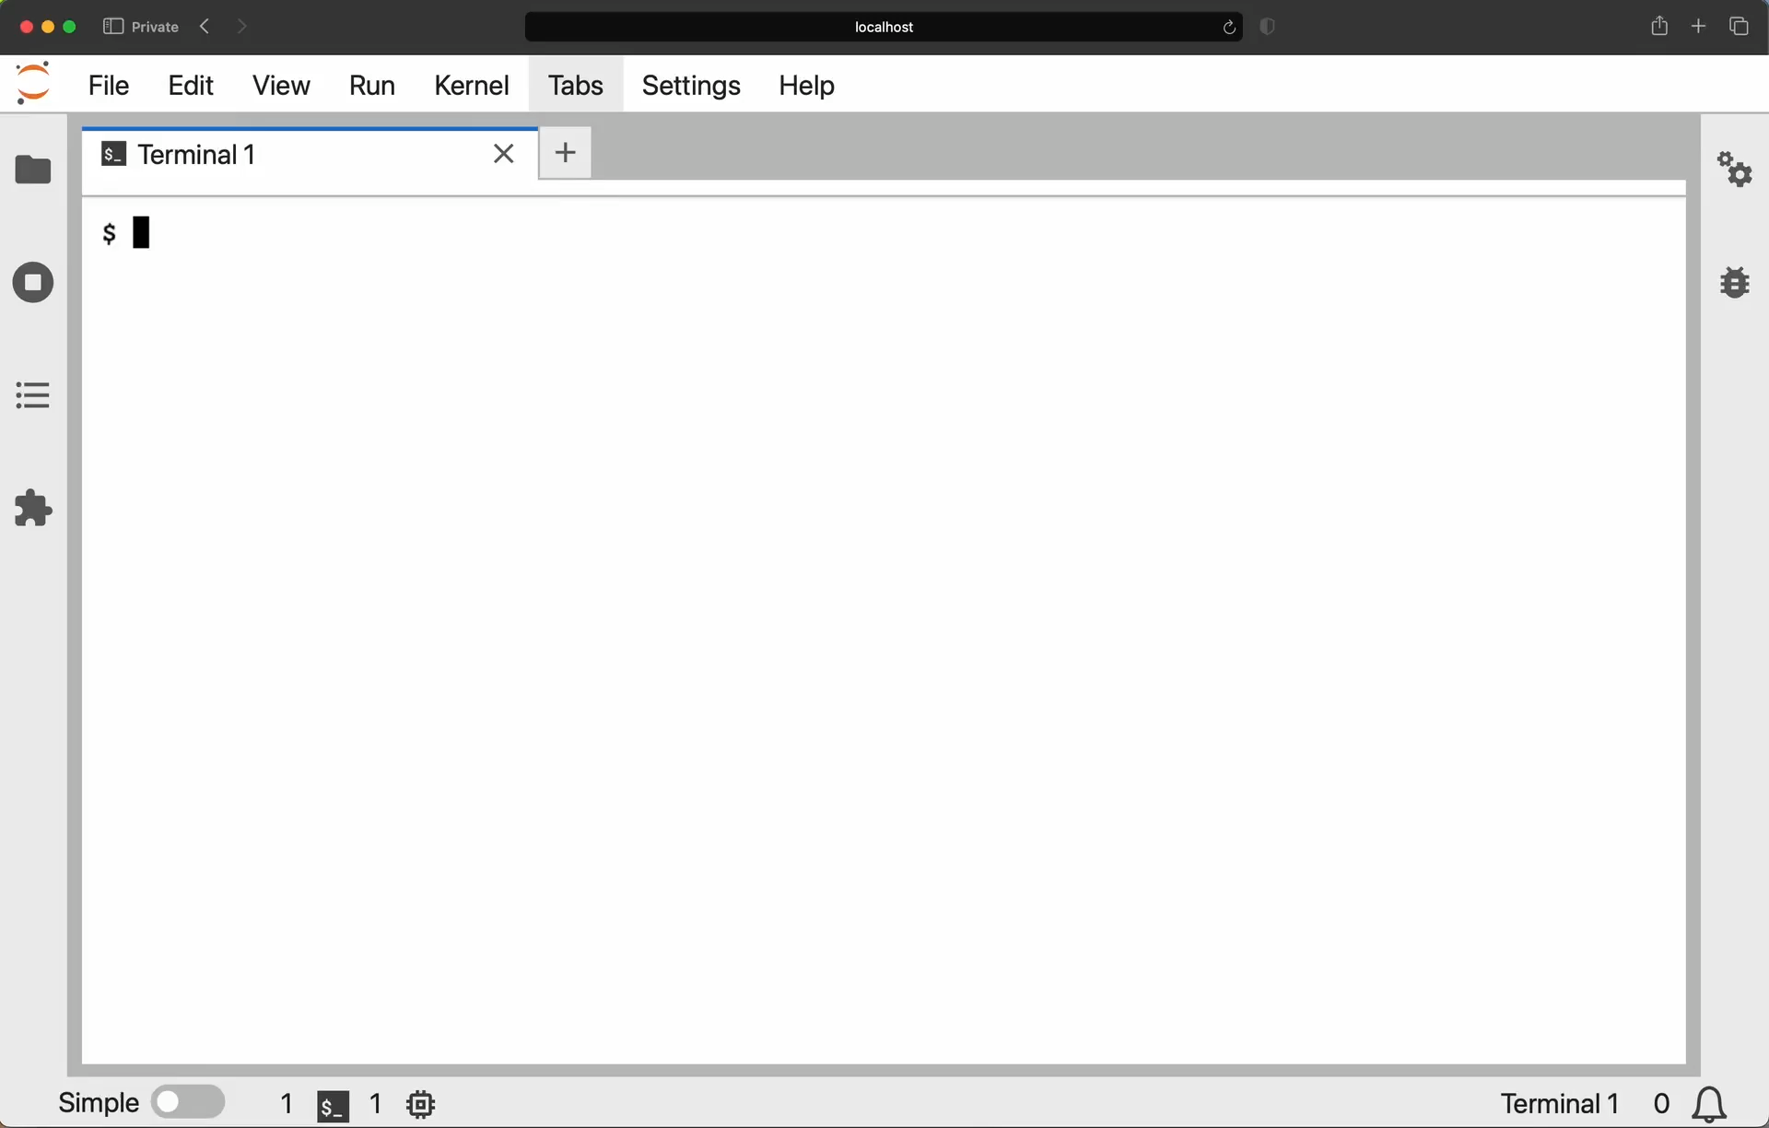

Slide 4
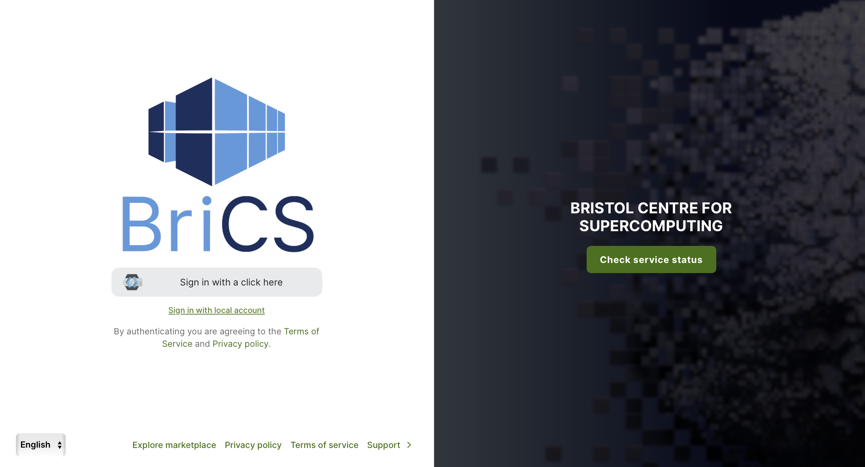
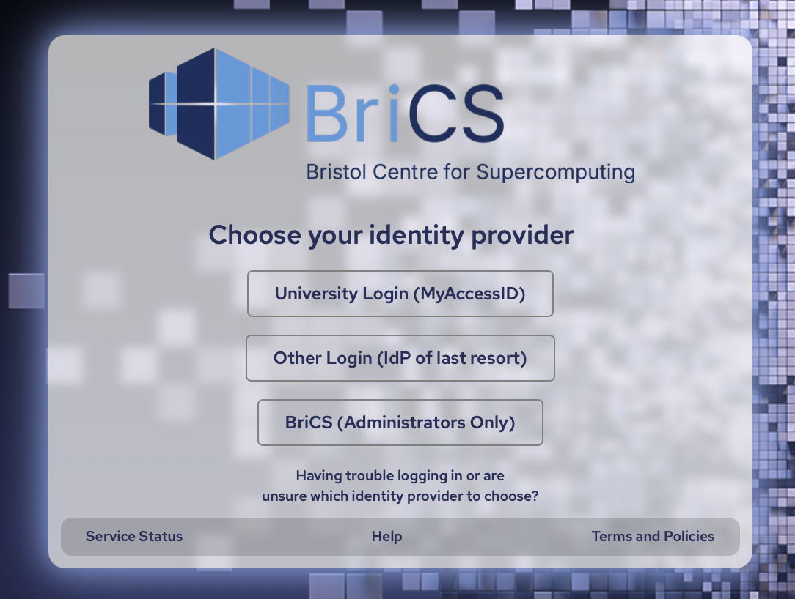
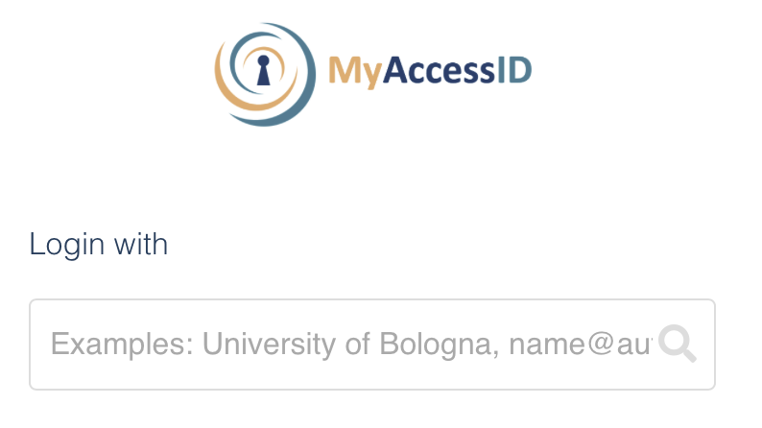
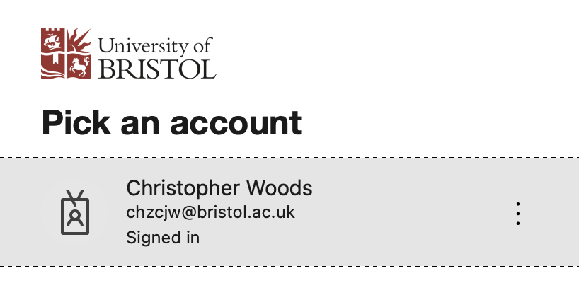
Give me an
authenticated
identity
Waldur
https://portal.isambard.ac.uk
Keycloak – Identity Broker
Give me an
authenticated
identity
Employer (University) Identity Provider (IdP)
Identifies and authenticates the individual
MyAccessID
Identity Federation based on Edugain

Slide 5
christopher.woods@bristol.ac.uk
Christopher
Woods
Waldur
https://portal.isambard.ac.uk
Keycloak – Identity Broker
christopher.woods@bristol.ac.uk
Christopher
Woods
Employer (University) Identity Provider (IdP)
Identifies and authenticates the individual
MyAccessID
Identity Federation based on Edugain

Slide 6
Authentication versus Authorisation
MyAccessID authenticates – IdP assures us that the individual logged in(*)
(*) really, someone in control of the account recently logged in…
MyAccessID is supported internationally – just because someone can authenticate does NOT mean that they are authorised to connect!
A successful MyAccessID authentication DOES NOT say anything about whether t a user is authorised (allowed) to log in
Authorisation is about saying are they allowed to log in

Slide 7
Project-Based Authorisation
Keycloak
Keycloak asks Waldur – Waldur says yes if they are a member of, or have been invited to join an active project
Says no if not…
Keycloak receives attributes that say which projects on which services they are authorised to use
Attributes used to allow access, i.e. used by clifton/conch to sign SSH certificates to ssh to clusters
Can christopher.woods@bristol.ac.uk log in?
Yes – member of brics project on Isambard-AI and Isambard 3
Waldur

Slide 8
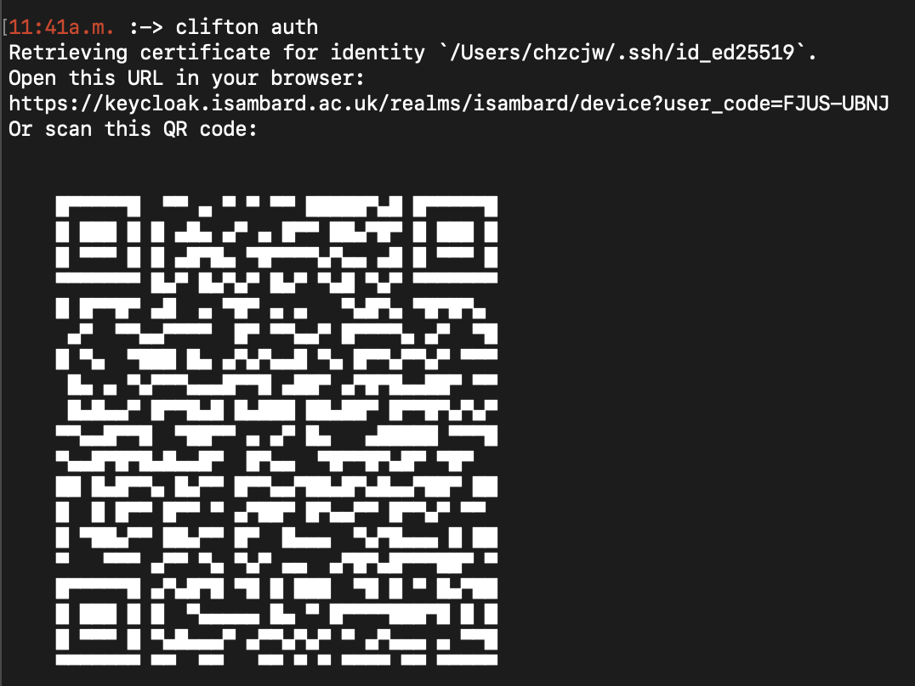

Clifton
Conch
Sign my SSH key
https://conch.readthedocs.io

Slide 9
Clifton
Conch
Sign my SSH key
https://conch.readthedocs.io
Get authorisation attributes
Keycloak

Slide 10
Clifton
Conch
Sign my SSH key
https://conch.readthedocs.io
Bristol IdP
Get authorisation attributes
Authenticate
Authenticate
Keycloak
MyAccessID

Slide 11
Clifton
Conch
Sign my SSH key
https://conch.readthedocs.io
Bristol IdP
Get authorisation attributes
Authenticate
christopher.woods@bristol.ac.uk
Authenticate
christopher.woods@bristol.ac.uk
Keycloak
MyAccessID

Slide 12
Clifton
Conch
Sign my SSH key
https://conch.readthedocs.io
Bristol IdP
Get authorisation attributes
Authenticate
christopher.woods@bristol.ac.uk
Authenticate
christopher.woods@bristol.ac.uk
Get authorisation attributes for christopher.woods@bristol.ac.uk
Waldur
Keycloak
MyAccessID

Slide 13
Clifton
Conch
Sign my SSH key
https://conch.readthedocs.io
Bristol IdP
Get authorisation attributes
Authorised!
cwoods can access brics@isambard-ai, demo@isambard3 etc.
Authenticate
christopher.woods@bristol.ac.uk
Authenticate
christopher.woods@bristol.ac.uk
Get authorisation attributes for christopher.woods@bristol.ac.uk
Waldur
Keycloak
MyAccessID

Slide 14
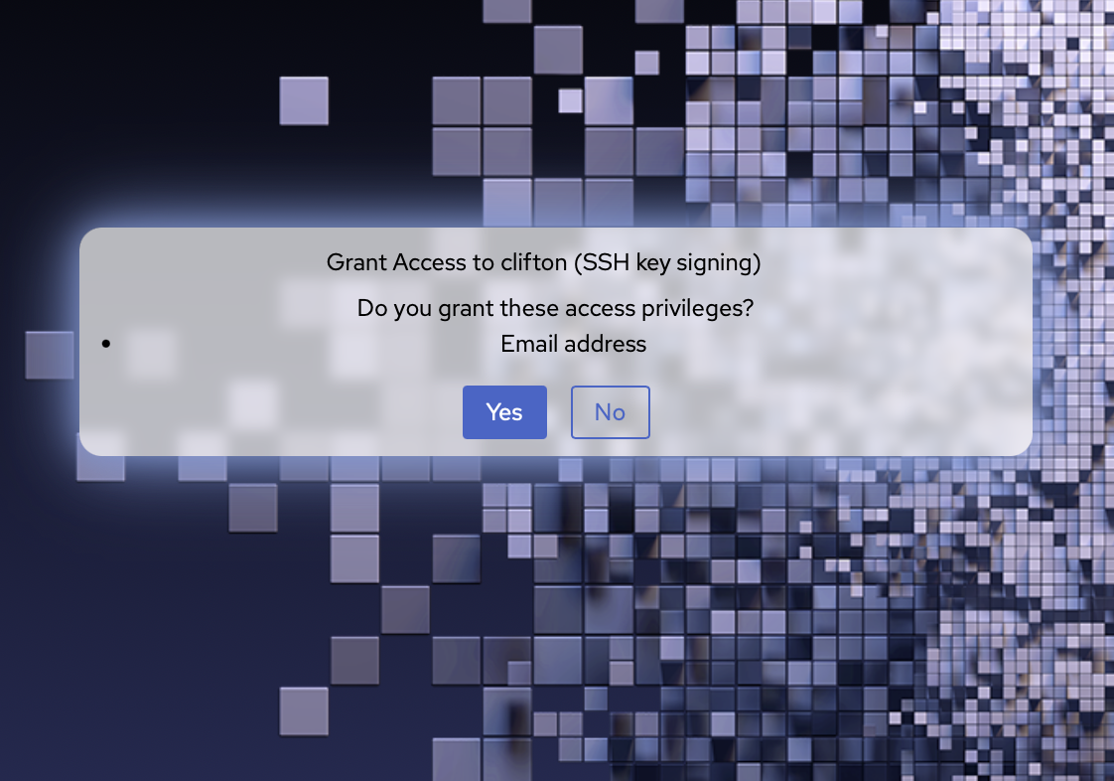
Clifton
Conch
Sign my SSH key
https://conch.readthedocs.io
Bristol IdP
Get authorisation attributes
Authorised!
cwoods can access brics@isambard-ai, demo@isambard3 etc.
Authenticate
christopher.woods@bristol.ac.uk
Authenticate
christopher.woods@bristol.ac.uk
Get authorisation attributes for christopher.woods@bristol.ac.uk
Waldur
Keycloak
MyAccessID

Slide 15
Clifton
Conch
Sign my SSH key
https://conch.readthedocs.io
Bristol IdP
Authorised!
cwoods can access brics@isambard-ai, demo@isambard3 etc.
Get authorisation attributes
Authorised!
cwoods can access brics@isambard-ai, demo@isambard3 etc.
Authenticate
christopher.woods@bristol.ac.uk
Authenticate
christopher.woods@bristol.ac.uk
Get authorisation attributes for christopher.woods@bristol.ac.uk
Waldur
Keycloak
MyAccessID

Slide 16
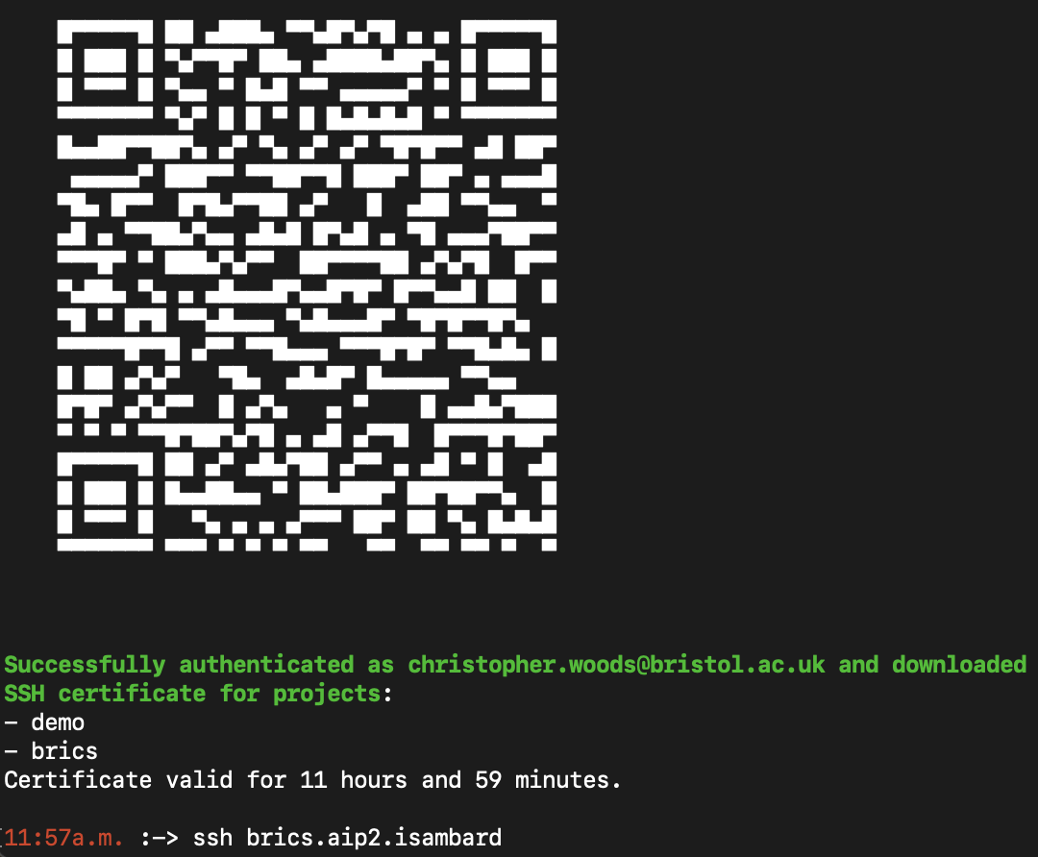

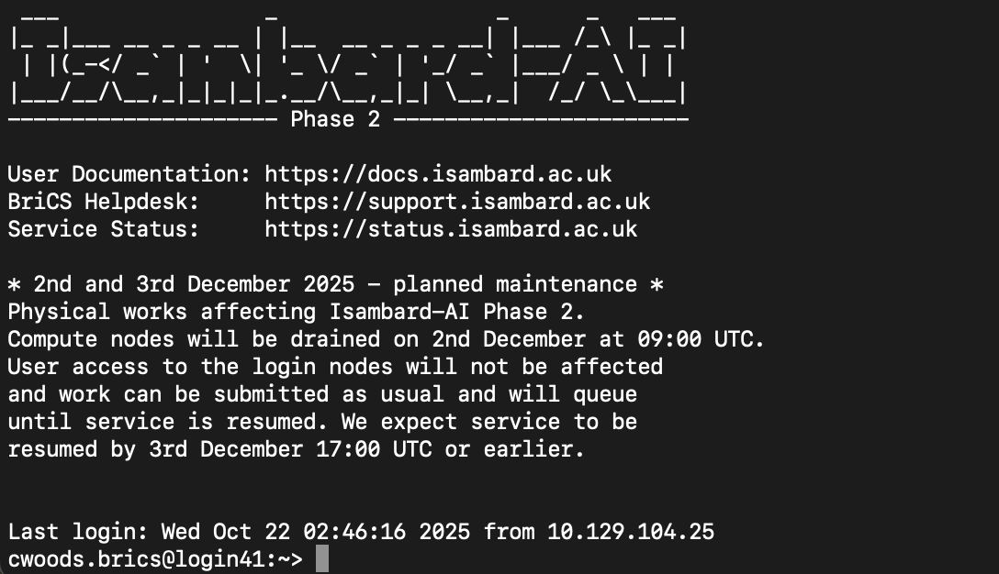
Clifton
Conch
Sign my SSH key
Certificate
https://conch.readthedocs.io
Bristol IdP
Authorised!
cwoods can access brics@isambard-ai, demo@isambard3 etc.
Get authorisation attributes
Authorised!
cwoods can access brics@isambard-ai, demo@isambard3 etc.
Authenticate
christopher.woods@bristol.ac.uk
Authenticate
christopher.woods@bristol.ac.uk
Get authorisation attributes for christopher.woods@bristol.ac.uk
Waldur
Keycloak
MyAccessID

Slide 17
Compliance
Compliance makes things more complex
Strict rules on who can use the services
Trusted Research Agenda
Export Control Rules
Who is ultimately legally responsible for usage? Project Lead? Their employer? The group who allocated the project? (DSIT/UKRI?)

Slide 18
Compliance implemented in partnership with allocators (DSIT/UKRI)
Bristol automatic blocking of banned accounts / emails
Applicant manual provision of enough information for compliance / due diligence / subsidy control checks
UKRI manual review and auditing of how allocation was used and by whom
UKRI manual due-diligence, subsidy control and compliance approval (auditable)
Bristol manual review of project team invitations that are not “allow-listed”
Bristol automatic review of invitable email domains
Application
Assessment
Award
Access
Accounting
Allocator launches call after gaining approval from UKRI and discussions with Bristol / Cambridge
Bristol manual review of UKRI-provided information
Check for potential identity / organisation violations. Pass back to UKRI if detected
Bristol automatic geo-ip controls block access from disallowed regions
Bristol automatic logging of logins, access, resource consumption (auditable)
Allocator manual assessment of application, passing compliance-related info to UKRI so they can do compliance checks
Bristol automatic Access Terms display / acceptance check (auditable)
…automatic and manual reviews and controls mitigate risk

Slide 19
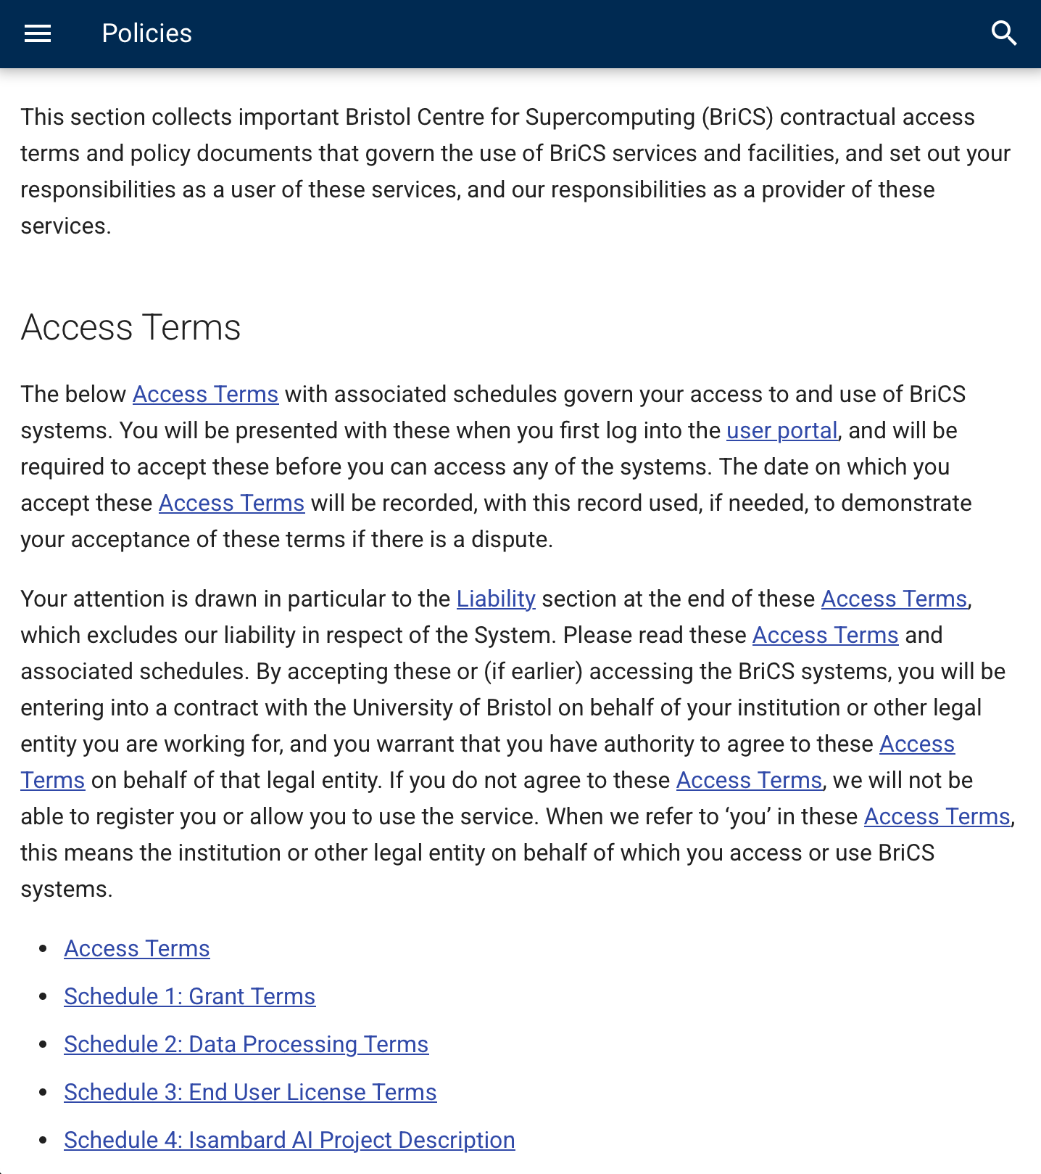
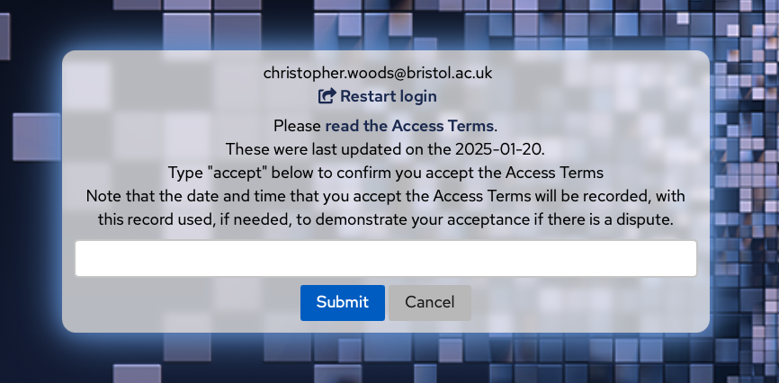
Keycloak
Accepted latest access terms?
Access blocked until they accept…
https://docs.isambard.ac.uk/policies

Slide 20
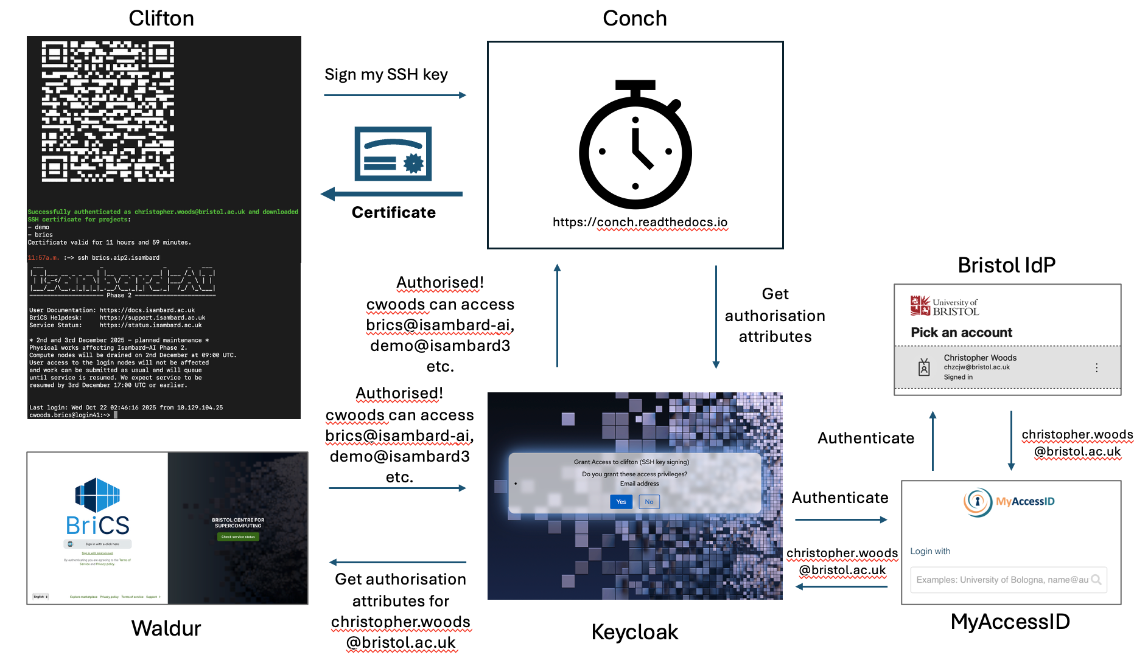
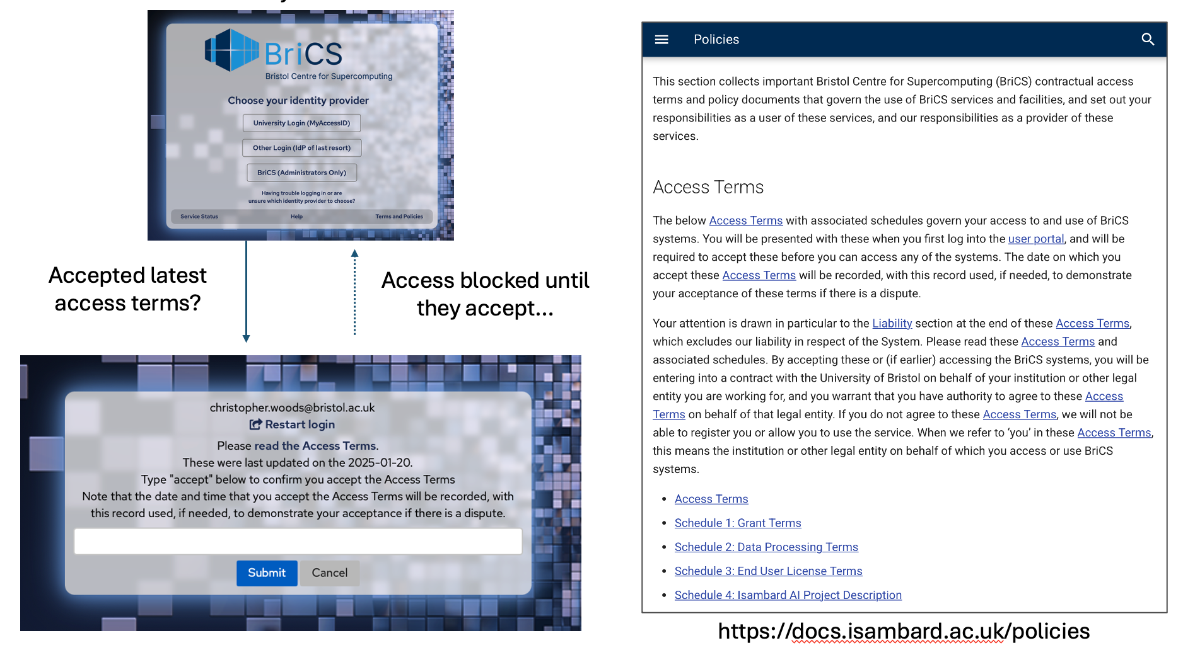
Key components
MyAccessID
Authentication
Waldur
Authorisation
Keycloak
Coordination / Compliance
Conch
Signing certificates

Slide 21
Conclusion
Combination of MyAccessID, Keycloak, Waldur and Conch gives us a highly-automated, self-service, federated project management and user authentication and authorisation platform
Been in production for ~18 months
>400 active projects, >1500 users

Slide 22
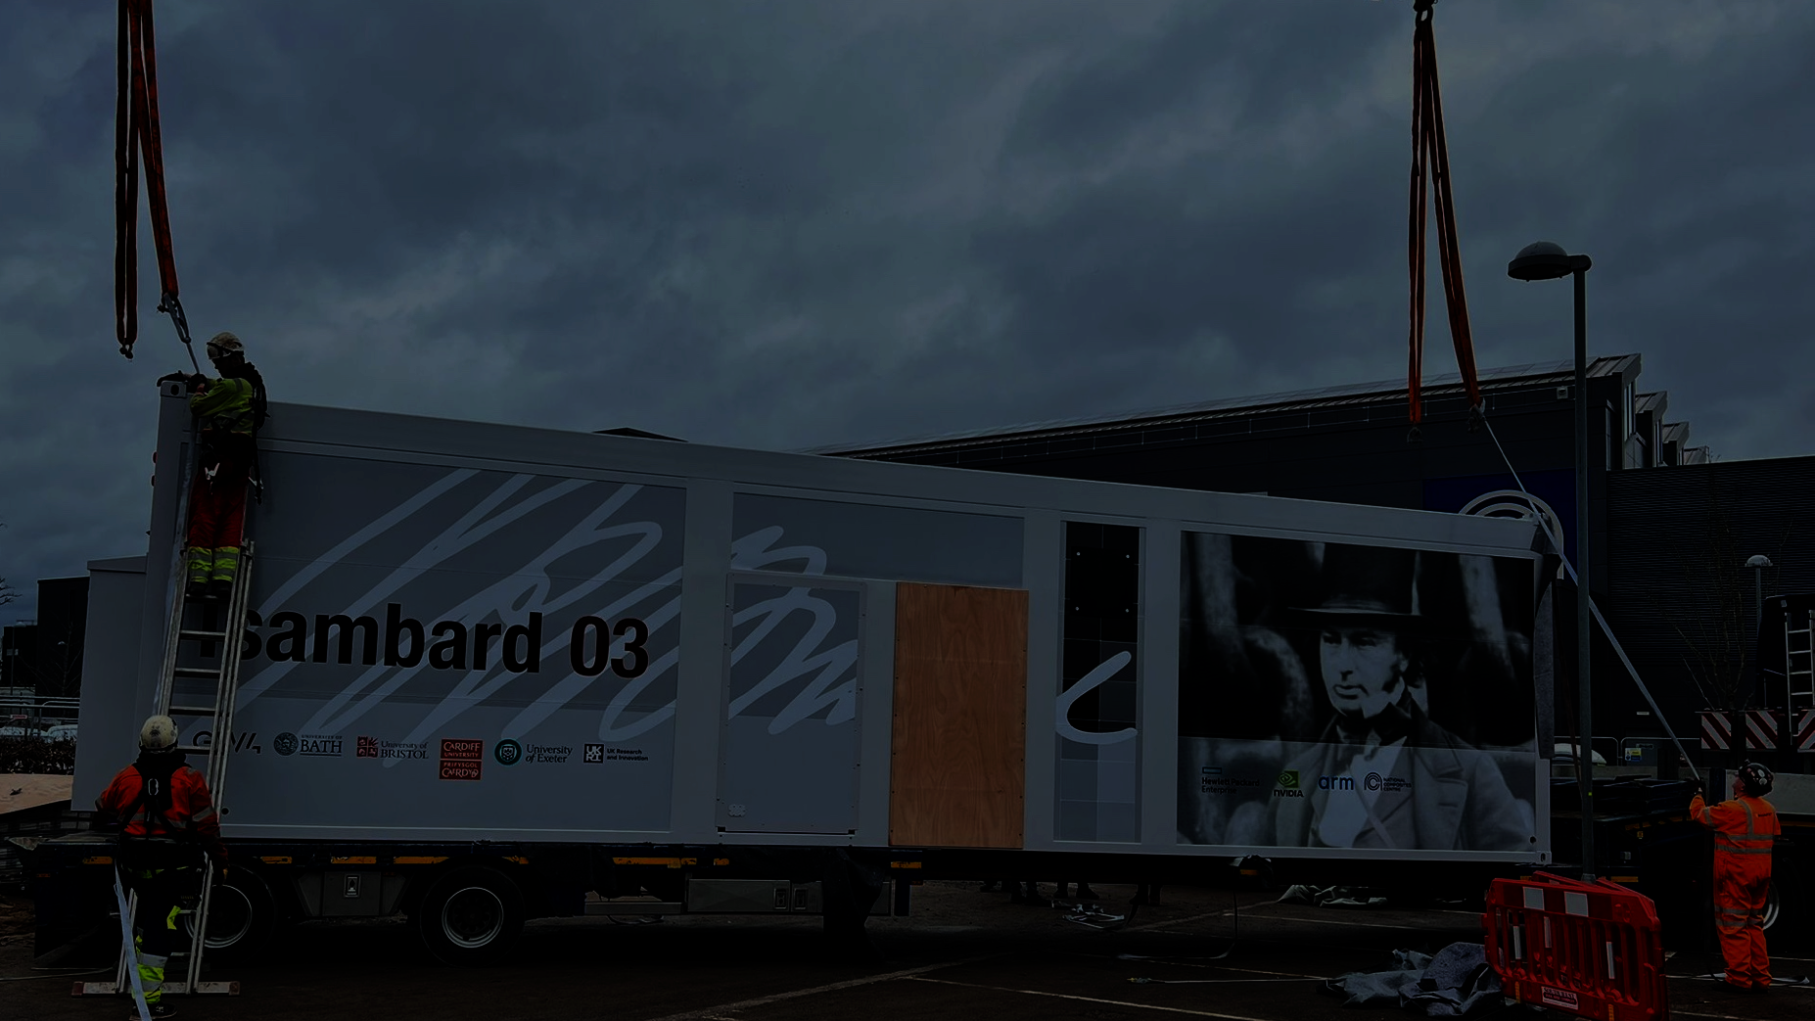


Acknowledgements
Isambard-AI is funded by the UK Government’s Department of Science, Innovation and Technology (DSIT) via UKRI / STFC. The project has only been possible thanks to a very talented and extremely hardworking team of people across the University of Bristol, HPE, Contour, NVIDIA, the National Composites Centre, and our building contractors, Oakland.
brics-enquiries@bristol.ac.uk
https://www.bristol.ac.uk/supercomputing/

